Slide 1

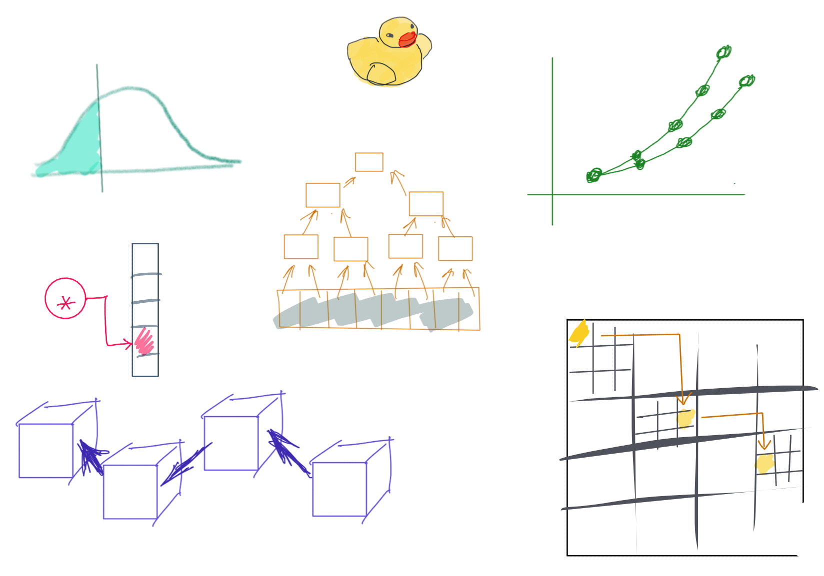

Slide 2
CSS342 Data Structures, Algorithms, and Discrete Mathematics (I)

Slide 3
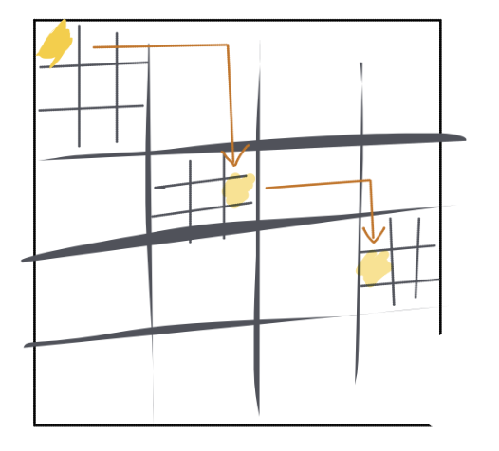
^{8th} Week Schedule
Midterm Review (Wed)
Homework 4 review (Wed)
Recursion practice
Quiz – 3, due next week
Percentile, Tree ADT (Friday)
Homework 5 to go live on Friday

Slide 4

Study Right

Slide 5
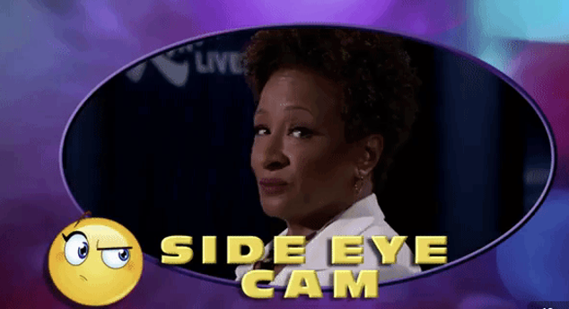
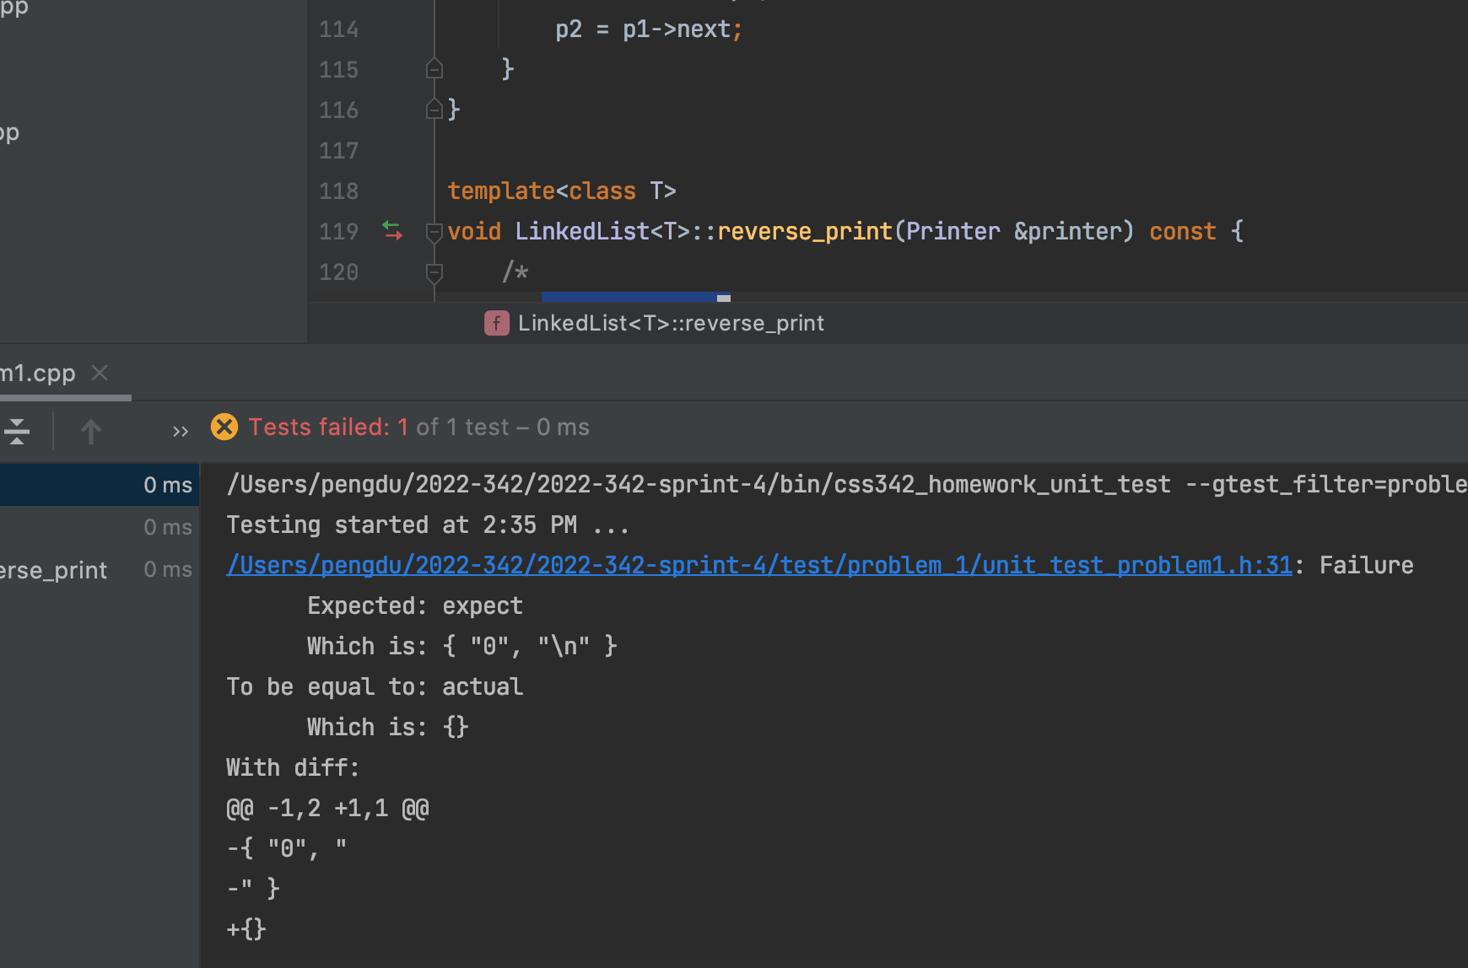
Ask The Right Question
“Professor. My test is failing. What’s wrong?”

Slide 6
Ask The Right Question
“My code doesn’t work.”
Which test case is failing?
What’s the specific error/failure?
What have your tried?
Breakpoint?
stackoverflow.com?
Google?

Slide 7
Ask the Right Question
“my code is failing with test case # ….
The specific error is …
I have checked … and ….”
Compiler error
Test case log
Code Logic
Debugger (breakpoint, stepping)
Memory issue (Linux)
Just google the damn error message!

Slide 8
Study Priority
Lecture PPT
Homework Code
Your code
Given code, e.g. tests
C++
Textbook
In-lecture demo
Code-along
Example code
Your technical debt items

Slide 9
Study Priority For Exams
C++
Sample Exam
Textbook
Code-along
Homework Code
Your code
Provided solution
Your technical debt items

Slide 10
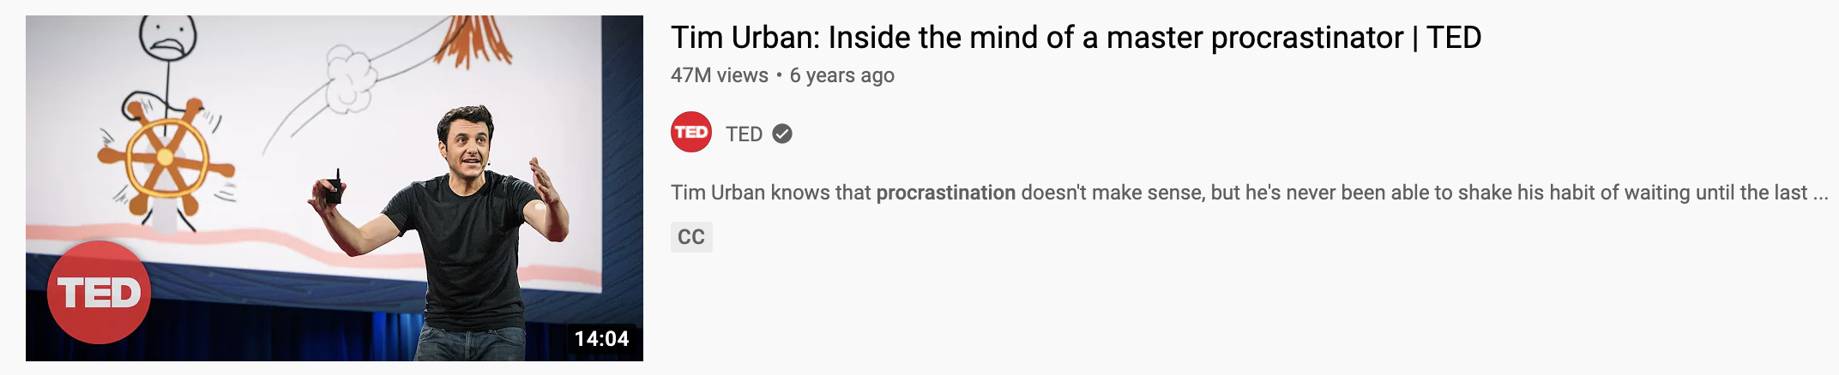
Beat Parkinson’s law
LINK
Have a plan
Have an estimate
Keep track of how long it takes for you to do a homework
Baby steps
Low hanging fruits
Fork, clone, new branch and PR
Compile code
Run tests

Slide 11
The “NOT MY FAULT” mindset
“What will I do differently if I can’t change what others do?”
Self-evaluation feedback loop

Slide 12
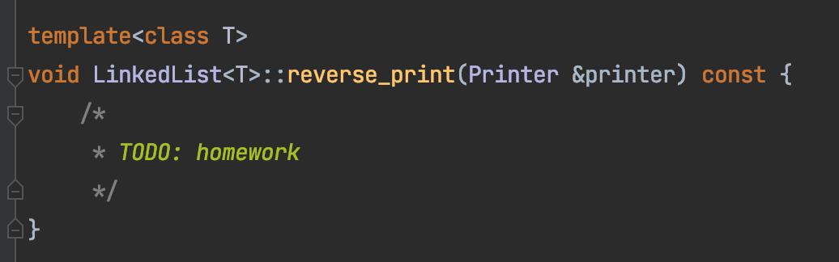
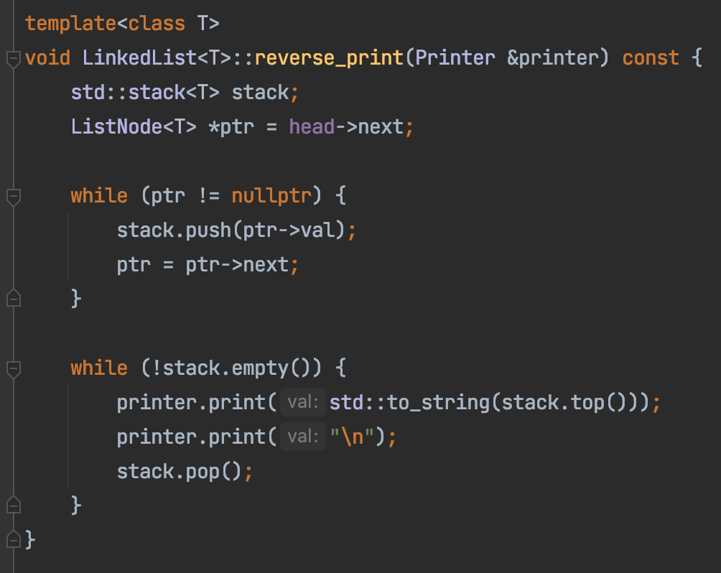
Homework 4 – Task 1
h
1
2
3
4
n
Create a stack
Traverse the list front to end, push each element onto a stack
Loop till the stack is empty,
Pop out every element from the stop
print the element

Slide 13
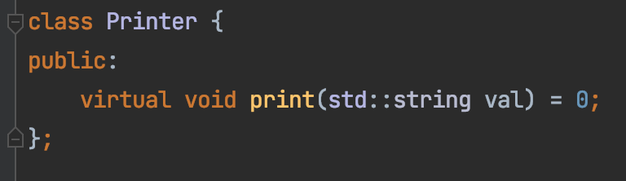
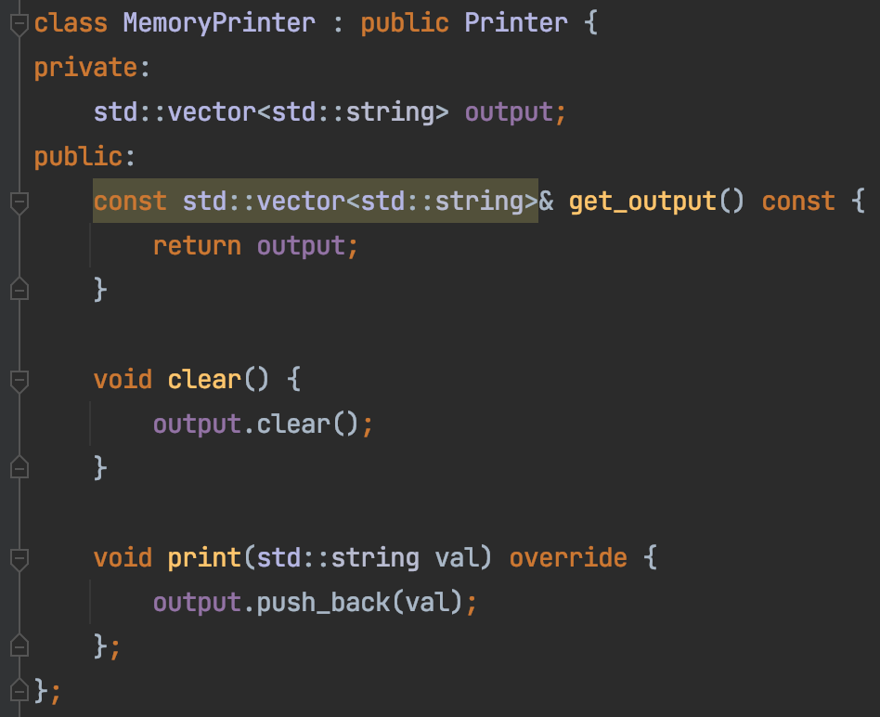

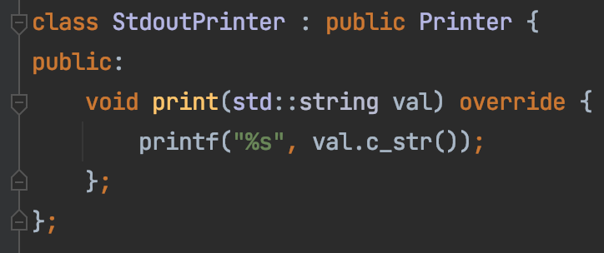
Homework 4 – Task 1
Decouple our code from how print is done
Interface
Implementation – For real use
Implementation – For testing

Slide 14
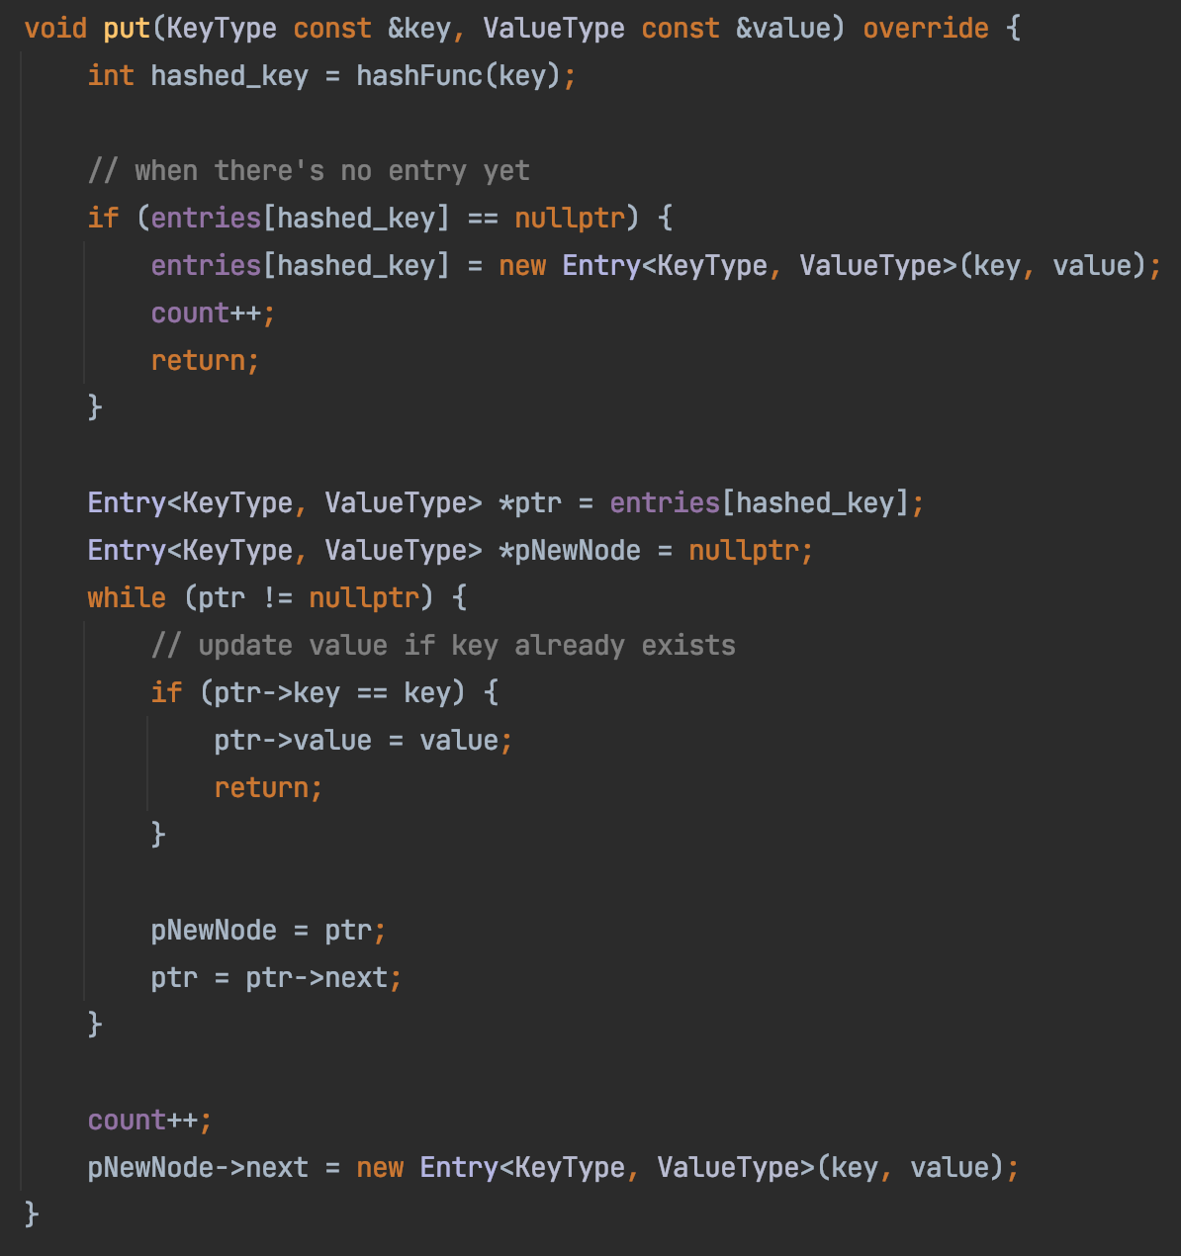
Homework 4
Tom
ArrayMap
Sam
Ron
Alex
Jerry
Joe
Tim
Hank

Slide 15
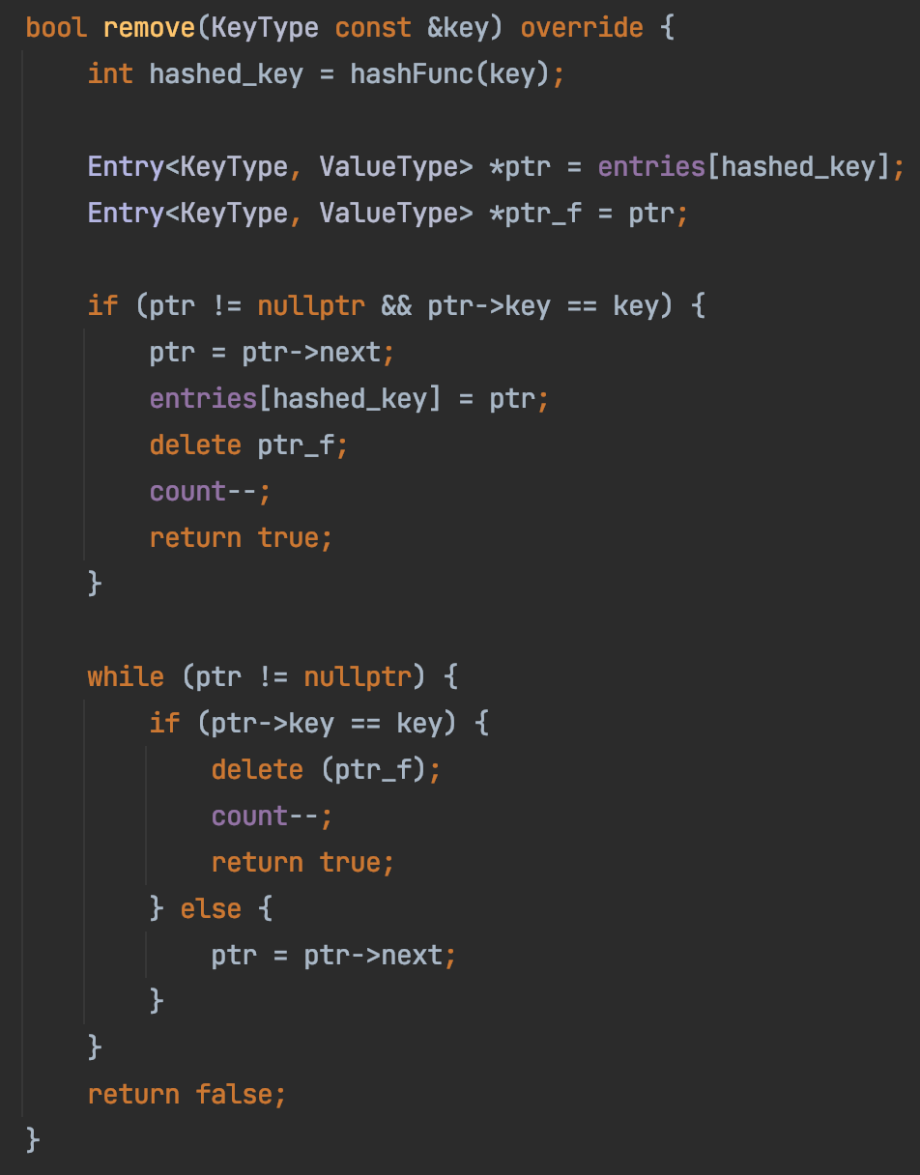
Homework 4
ArrayMap
Sam
Ron
Alex
Jerry
Joe
Tim
Hank

Slide 16
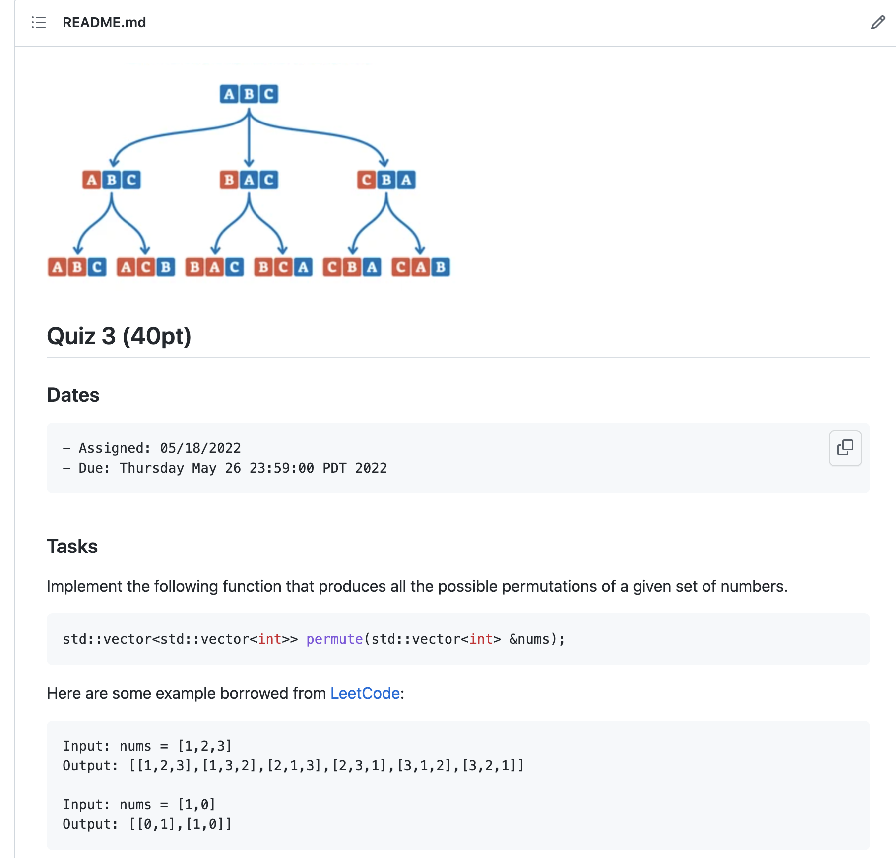
In-class Practice & Quiz-3
Based on https://leetcode.com/problems/permutations

Slide 17
1
1
1
2
1
2
2
1

Slide 18
2
3
1
3
2
1
3
2
1
2
3
3
1
1
2
3
2
1

Slide 19




$$P([1])$$
1
1
1
2
$$P([2])$$
$$P([1,2])$$
1
2
2
1
$$P([1])$$

Slide 20
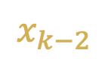


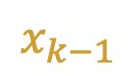
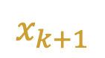
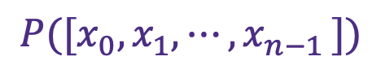
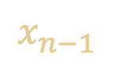

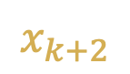
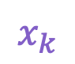
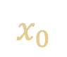
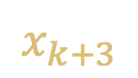
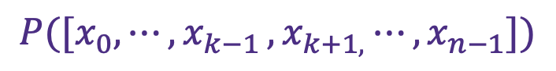


$$x_{0}$$
$$⋮$$
$$x_{k−3}$$
$$x_{k−2}$$
$$x_{k−1}$$
$$P([x_{0},x_{1},{⋯,x}_{n−1}])$$
$$=$$
$$x_{k}$$
$$,$$
$$P([x_{0},{⋯,x}_{k−1}{{,x}_{k+1,}⋯,x}_{n−1}])$$
$$x_{k+1}$$
$$x_{k+2}$$
$$x_{k+3}$$
$$⋮$$
$$x_{n−1}$$

Slide 21




2
3
1
$$P([2,3])$$
3
2
$$P([1,2,3])$$
1
3
2
1
2
3
$$P([1,3])$$
3
1
1
2
3
$$P([1,2])$$
2
1

Slide 22
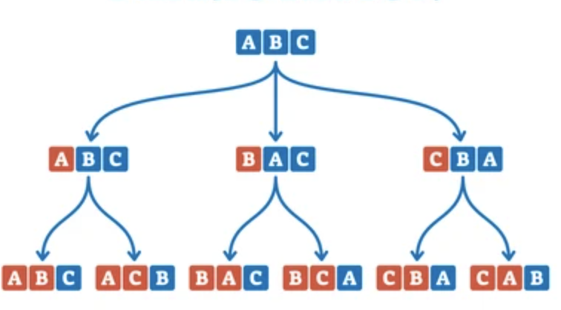


Quiz 3
Input: {1,2,3}
Input: {3,2,1}
Input: {3,2,1}
output:
{
{1,2,3}
{1,2,3}
{2,1,3}
{2,3,1}
{3,1,2}
{3,2,1}
}
output:
{
{1,2,3}
{1,2,3}
{2,1,3}
{2,3,1}
{3,1,2}
{3,2,1}
}
output:
{
{2,1,3}
{2,3,1}
{1,2,3}
{3,1,2}
{1,2,3}
{3,2,1}
}

Slide 23
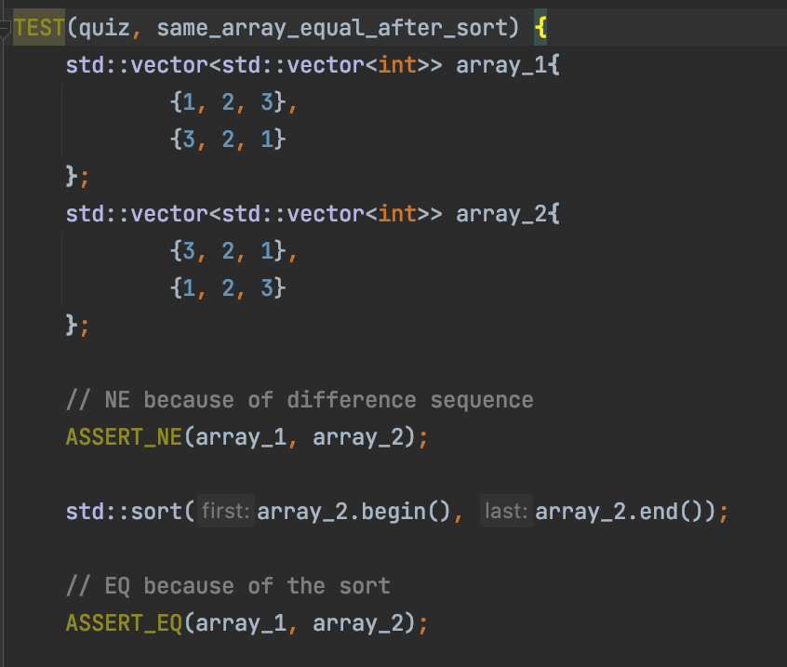
Quiz 3
Input: {1,2,3}
Input: {3,2,1}
output:
{
{1,2,3}
{1,2,3}
{2,1,3}
{2,3,1}
{3,1,2}
{3,2,1}
}
output:
{
{1,2,3}
{1,2,3}
{2,1,3}
{2,3,1}
{3,1,2}
{3,2,1}
}

Slide 24
Quiz 3
How to test it when n > 7?

Slide 25
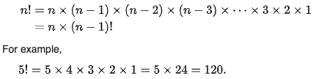
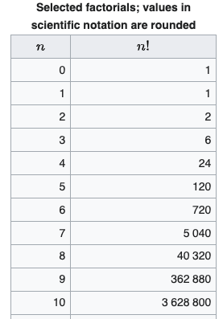
Quiz 3
How many answers?
Input: {1,2,3}
output:
{
{1,2,3}
{1,2,3}
{2,1,3}
{2,3,1}
{3,1,2}
{3,2,1}
}
https://en.wikipedia.org/wiki/Factorial

Slide 26
Quiz 3
Are all answers unique?
Input: {4,1,2, 3}
Input: {4,1,2,3}
output:
{
{1,4,2,3}
{1,3,2,4}
{2,1,3,4}
{4,2,3,1}
{1,4,2,3}
{3,4,2,1}
…
…
}
output:
{
{1,4,2,3}
{1,3,2,4}
{2,1,3,4}
{4,2,3,1}
{1,4,2,3}
{3,4,2,1}
…
…
}

Slide 27
Quiz 3
Are all answers unique?
Input: {4,1,2, 3}
Input: {4,1,2,3}
output:
{
{1,4,2,3}
{1,3,2,4}
{2,1,3,4}
{4,2,3,1}
{1,4,2,3}
{3,4,2,1}
…
…
}
How to check whether each vector is unique?

Slide 28
Quiz 3
Are all answers valid?
Input: {4,1,2, 3}
Input: {4,1,2,3}
output:
{
{1,1,2,3}
{1,3,2,4}
{2,1,3,4}
{4,2,3,1}
{1,4,2,3}
{3,4,2,1}
…
…
}
output:
{
{1,1,2,3}
{1,3,2,4}
{2,1,3,4}
{4,2,3,1}
{1,4,2,3}
{3,4,2,1}
…
…
}
How to check
{1,2,3,4} and {1,1,2,3}
don’t contain the same thing?

Slide 29
Quiz 3
How to test it when n > 7?
Output has correct number of vectors
Each vector is unique
Each vector contains the valid numbers

Slide 30
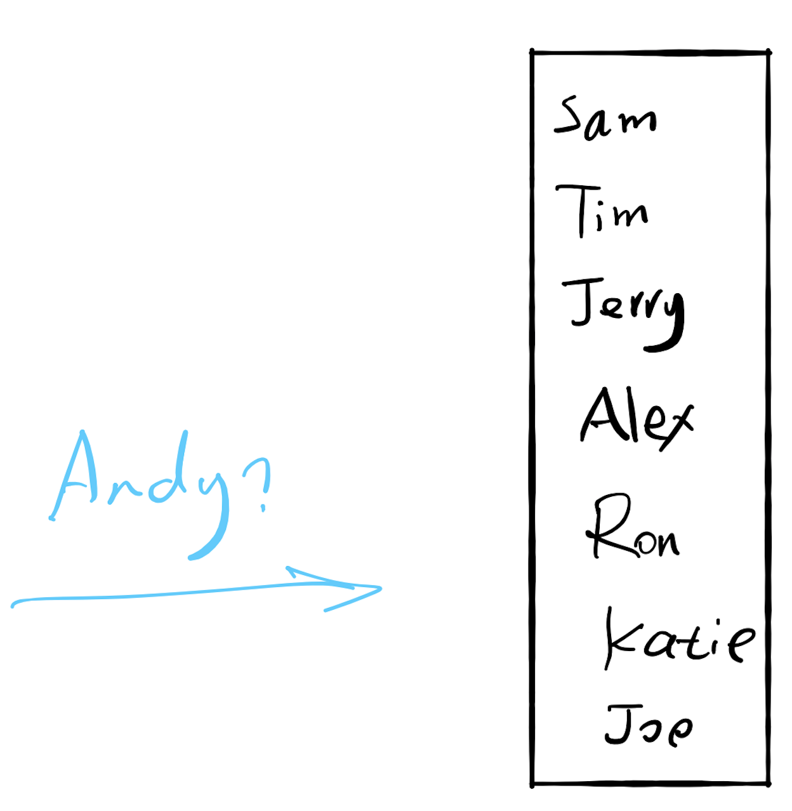

17.1 Search

Slide 31
If there are 10,000 users
Worst case: 10,000 seconds (2.8 hours)
Can we do better?
Sort

Slide 32
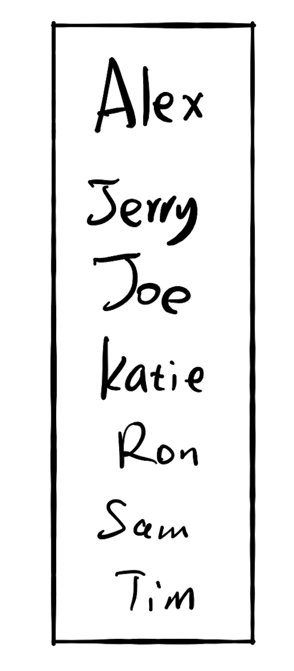
17.2 Insertion
If there are 10,000 users
Each memory ops takes 2 seconds

Slide 33
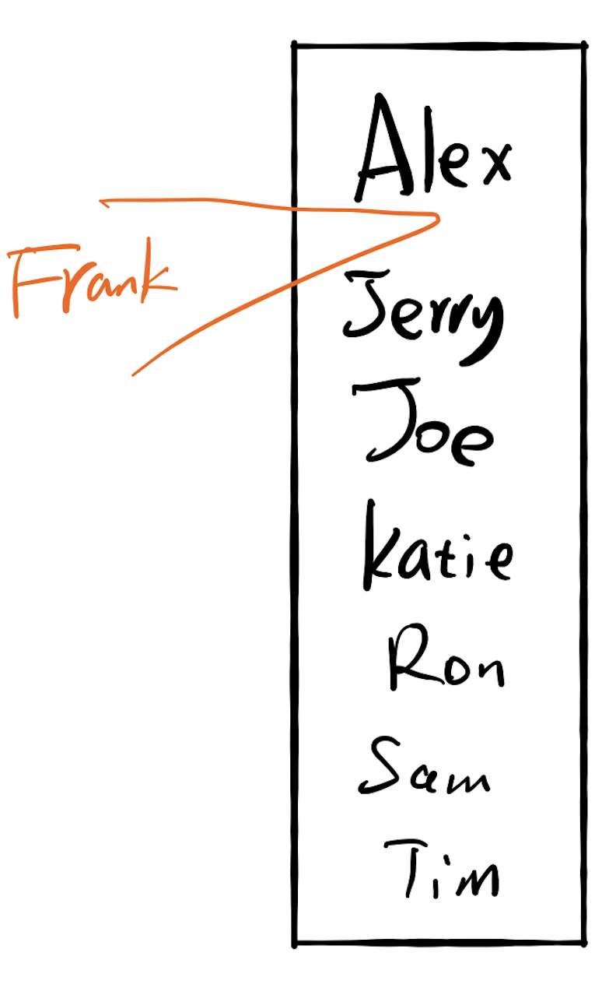
17.2 Insertion
If there are 10,000 users
Each memory ops takes 2 seconds
Search the location: 13.3 seconds
Insertion: $9,999 × 2 s$

Slide 34
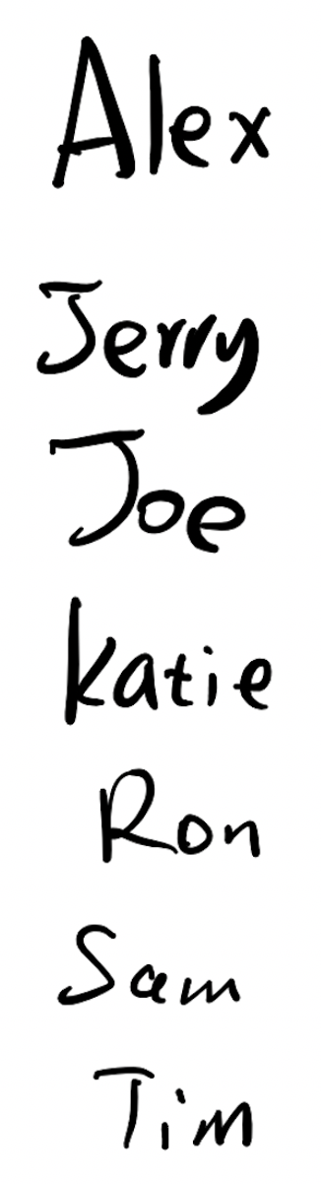

17.2 Insertion
If there are 10,000 users
Each comparison takes 1 seconds
Each memory ops takes 2 seconds
Insertion: $2s$
Search the location: ??

Slide 35
Fast for search
Slow for insertion
Slow for search
Fast for insertion

Slide 36
17.3 Do both fast?

Slide 37
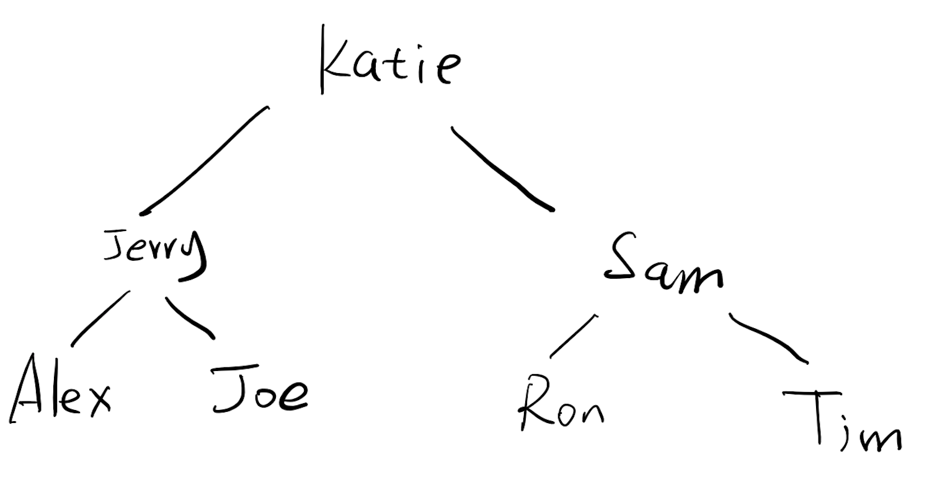

If there are 10,000 users
Each comparison takes 1 seconds
Each memory ops takes 2 seconds
Search the location:
13s
$$2s$$
Insertion:

Slide 38
A search problem
1
3
3
5
7
9
9
10
12
12
12
14
18
0
1
2
3
4
5
6
7
8
9
3
9
12
9
3
12
1
5
10
14
7
12
18

Slide 39
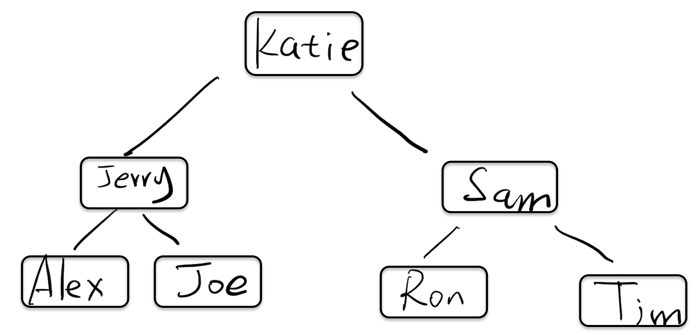
How do we implement this?

Slide 40
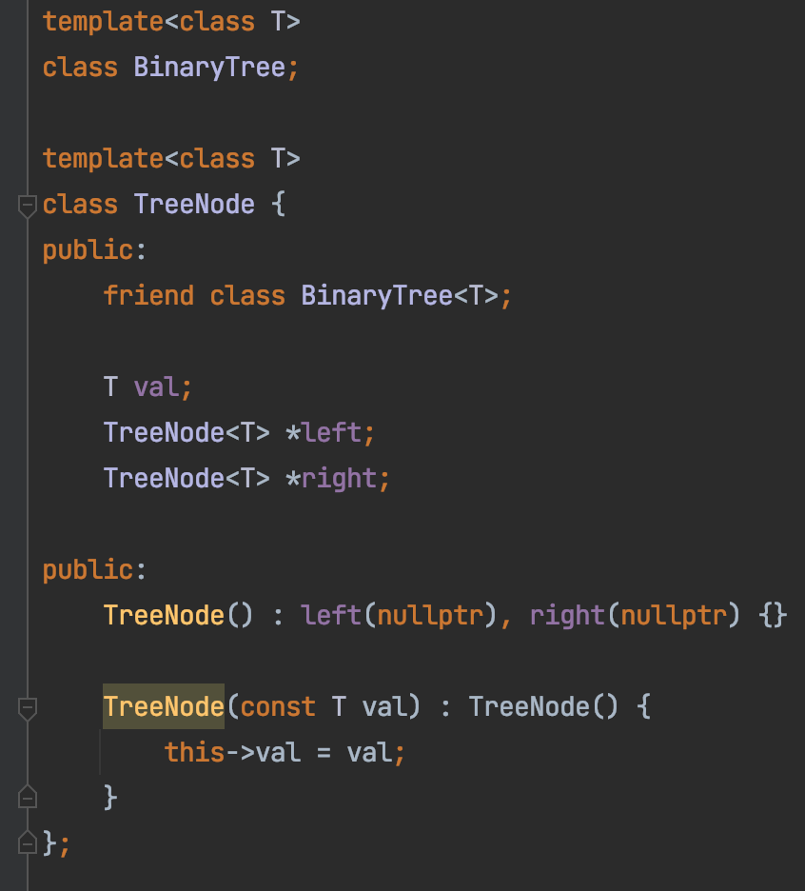

Slide 41
Binary Search Tree
A Binary Search Tree (BST) :
all the nodes follow the below-mentioned properties:
The left sub-tree of a node has a key less than or equal to its parent node's key.
The right sub-tree of a node has a key greater than to its parent node's key.

Slide 42
Exercise
Is this a binary search tree?
8
3
10
14
1
6
4
7

Slide 43
Exercise
Is this a binary search tree?
8
3
10
11
14
1
6
4
7

Slide 44
Exercise
Is this a binary search tree?
8
3
1
6
4
7

Slide 45
Exercise
Is this a binary search tree?
2
3
5
7
6
9

Slide 46

Demo
https://github.com/a-teaching-goose/2022-342-code-along/tree/2022-05-20

Slide 47
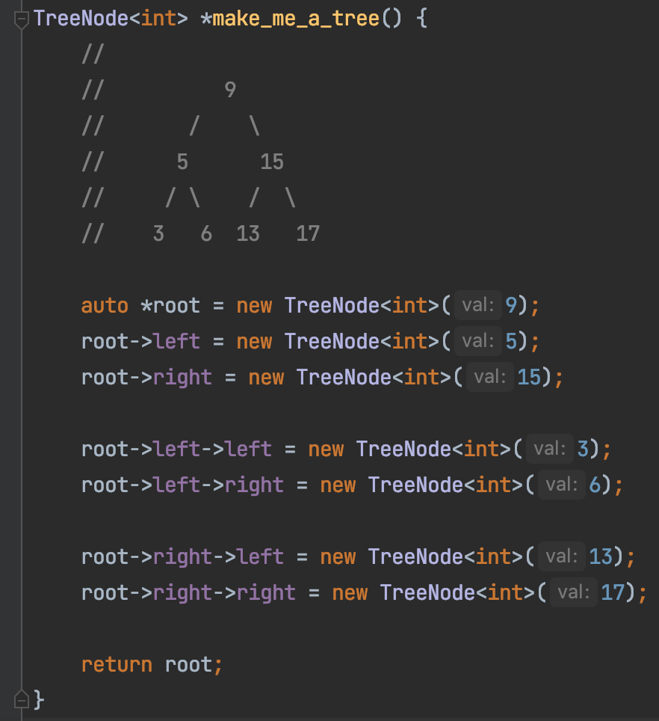
Build A BST

Slide 48
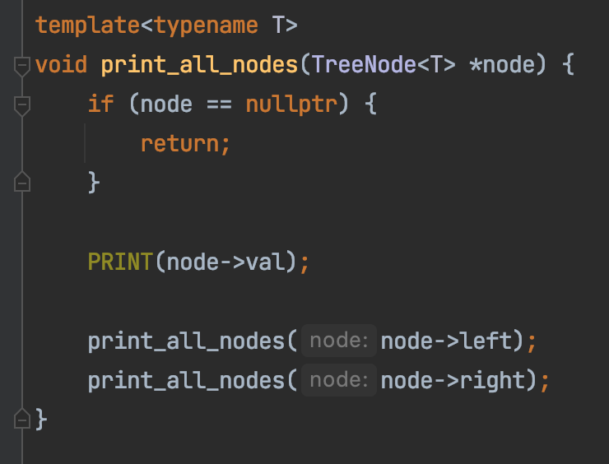
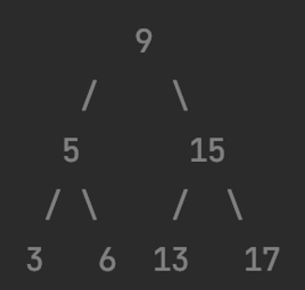
Print A BST

Slide 49
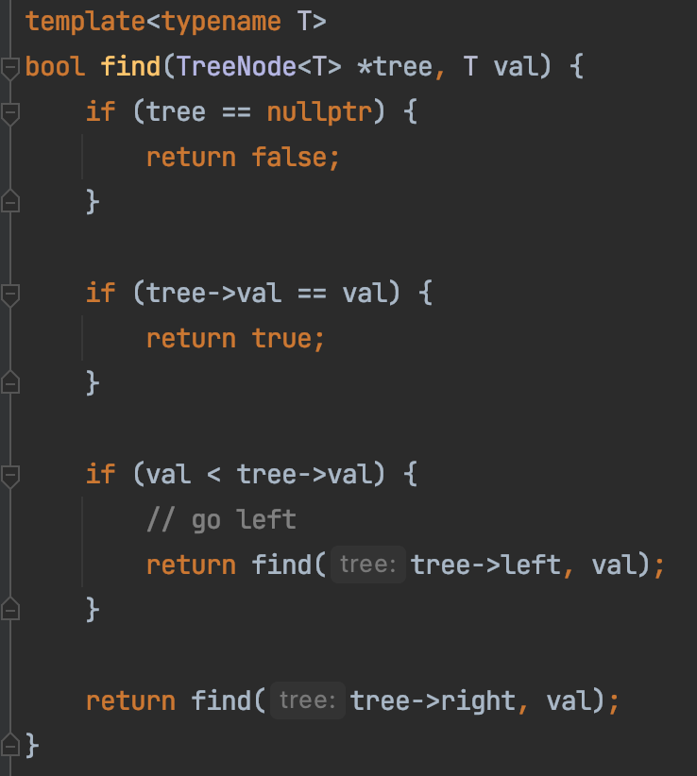
Search In A BST

Slide 50
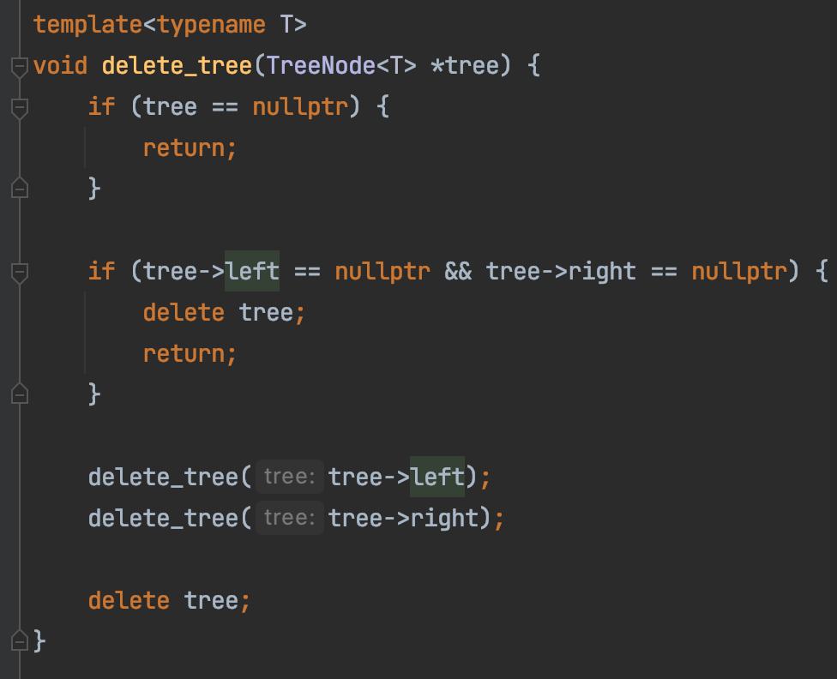
Delete A BST

Slide 51
Summary
Tree ADT
Faster Search than single linked list
Faster insertion/deletion than array
Faster range query than hashtable

Slide 52
LinkedList → Tree
Sam
Ron
Alex
Tom
Joe
Tim
Alex
Joe
Ron
Sam
Tom
Tim

Slide 53
Alex
Joe
Ron
Sam
Tom
Tim
Alex
Joe
Ron
Sam
Tim
Tom
Better worst case performance

